Slide 1
Little Center Inventory System
Software engineering project
Course: CSCI 250 (Spring 2019)
Professor: John Magee
Team members:
Alexander Rakovshik ‘19, Ishraq Salim Chowdhury ‘21, and Skyler Brivic ‘20

Slide 2
Client:
Kevin McGerigle
Technical Director & Theater Designer at Clark University
What problem does it solve?
People have been borrowing equipment (lights, speakers etc.) for events without formally signing the equipment out, making it unclear as to who has a given product and whether or not a missing product is truly missing, or is simply being used for an event.
Requirements:
An app/software/website that allows keeping track of inventory in the theater department
Print a label/assign a number to each lighting and sound equipment
Allow client to view online who has what item, when they took it, and when they brought it back.

Slide 3
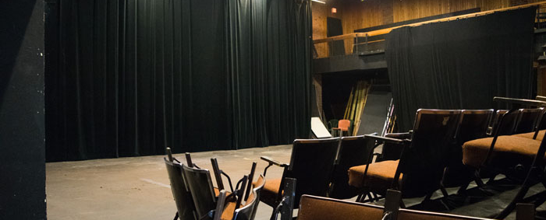
And the show begins…

Slide 4

Project deliverables:
An online database:
currently holds 75 items.
keeps track of who borrows item, contact information of borrower, what item borrowed, check-out time, check-in time, etc.
Quick Response (QR) codes for each item.

Slide 5
Database System:
For this project, we used a MySQL Database
The database contains a table storing information about each product, a table storing information about what transactions have occurred, and a table storing the personal information of each student who has rented equipment from the system.

Slide 6
Backend of Website:
The backend for the website was written using a series of java servlets and regular java classes
One useful feature we made was a class called “databaseInterface”
This class contains functions to perform common database features, and enables the servlets in the program to not be bound to using a specific database.

Slide 7
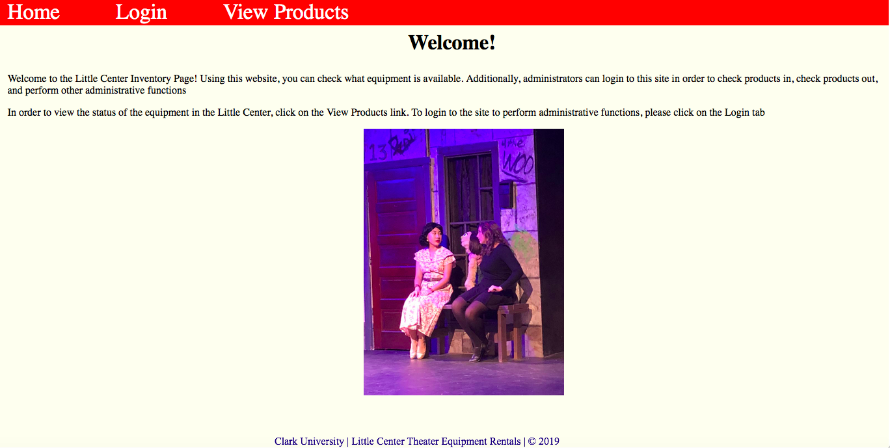
Frontend:

Slide 8
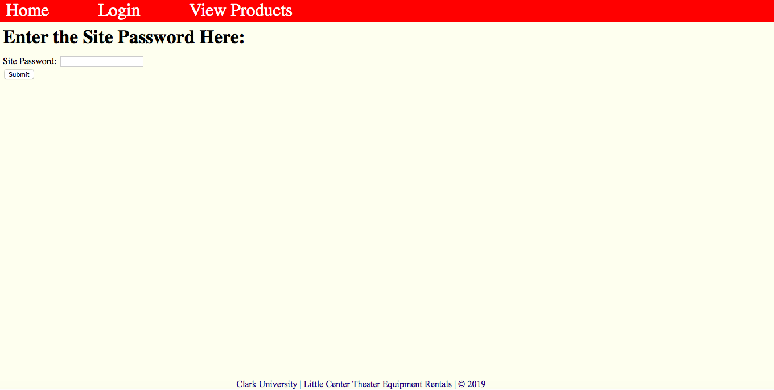
Frontend (continued):

Slide 9
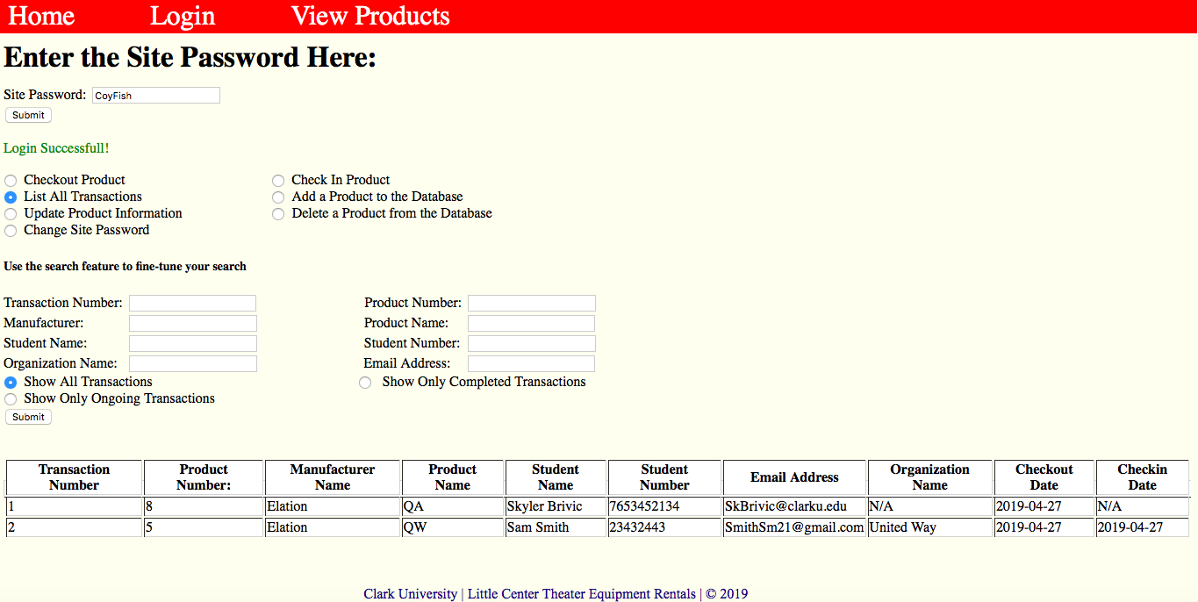
Frontend (continued):

Slide 10
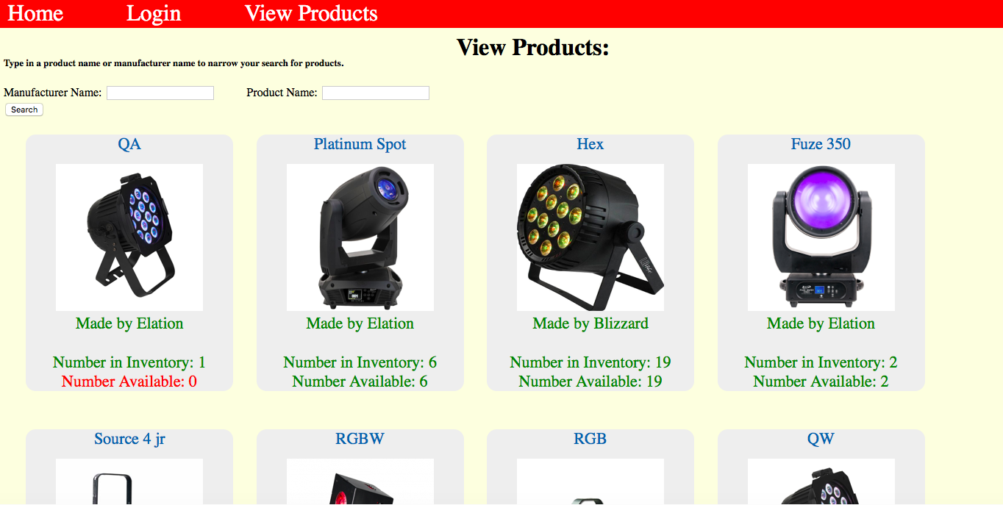
Frontend (continued):

Slide 11
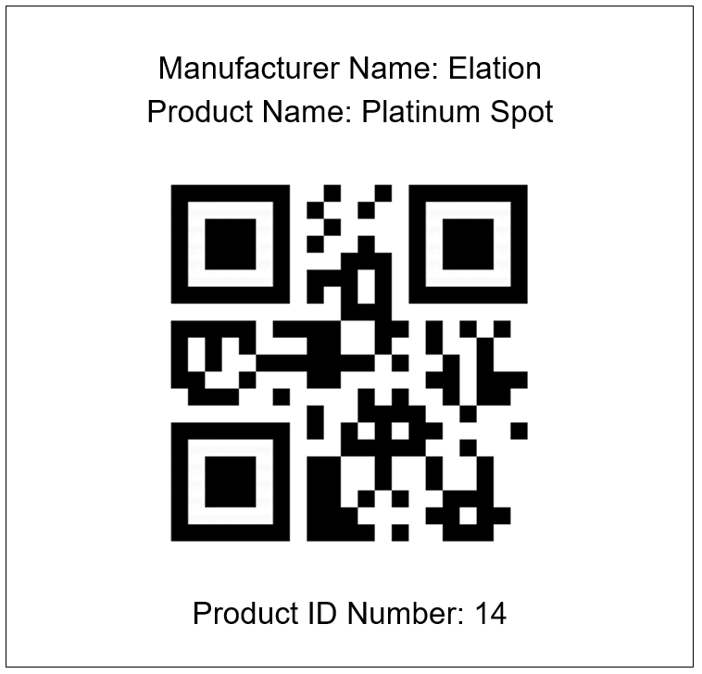
QR codes:
Purpose:
Scanning QR codes give the product ID number which can be inputted into the system.
Future goal:
Scanning QR code will lead directly to the database URL, once server is set up.

Slide 12
Talk about waterfall process (inception, planning, requirement analysis, etc.)
Can add screenshots of github, trello, slack to show communication side.
Can include email exchange with Kevin
Basically how we implemented stuff taught in class

Slide 13


Slide 14
THANK YOU
Have a great summer break!

Slide 15
Team dynamics:

